Slide 1

Project: In each kind of sports, what age of the players are more likely to get achievements?
—— Taking Olympic 2020 as the example
Notes:
In other words, what age of players are more likely to win the prize.

Slide 2
Agenda
Collecting data
Cleaning the data
Data analysis

Slide 3
The process of collecting data
Decide what kind of data should I collect?
1. Name of persons who get first prize
2. Female or male
3. Birth of the person
4. Age
5. Sport
Notes:
I decide the five kind of useful dataset.

Slide 4
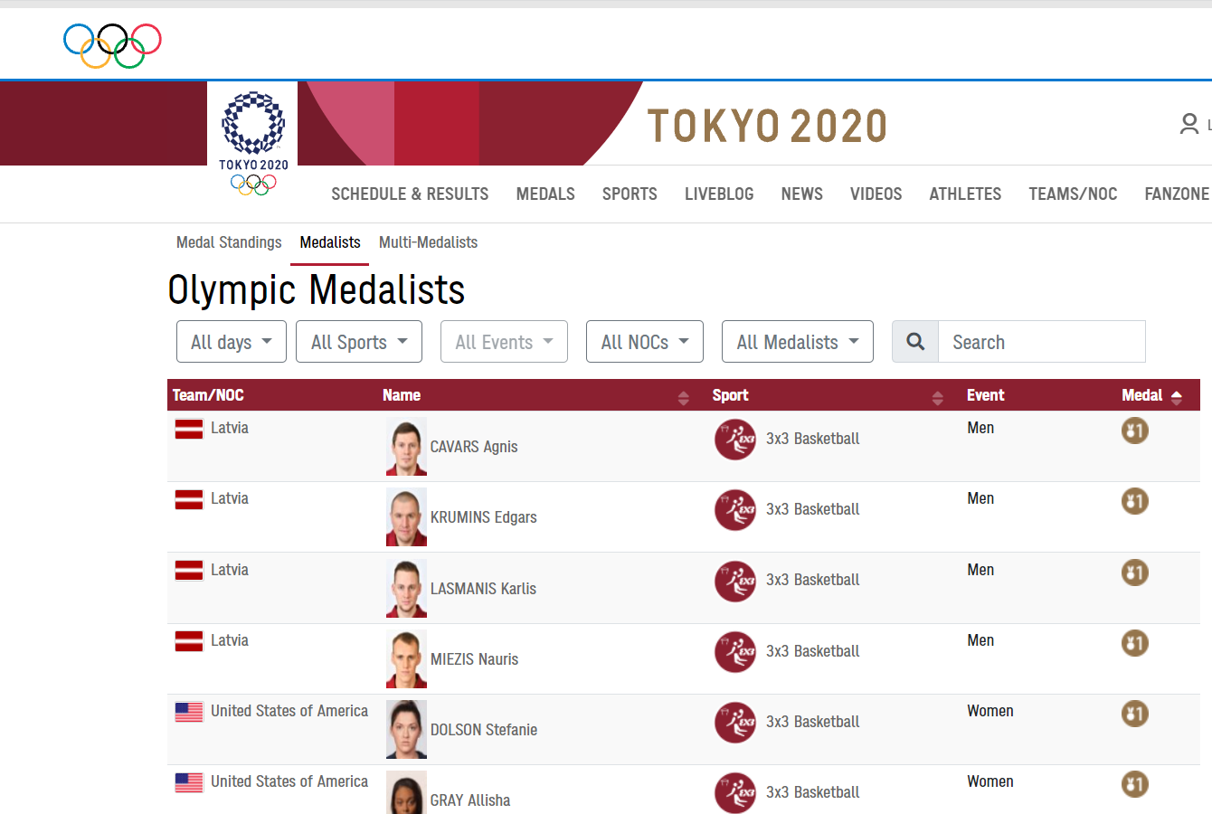
Where can I find the data?
Official website
https://olympics.com/tokyo-2020/olympic-games/en/results/all-sports/medalists.htm
(open database; easy to get on the website)

Slide 5
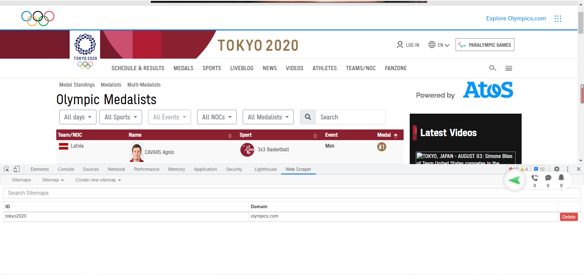
Use web scraper to scrape the data
Notes:
I think it is the most difficult part of the whole process of the project. Cuz I learnt just a little about the web scraper.

Slide 6
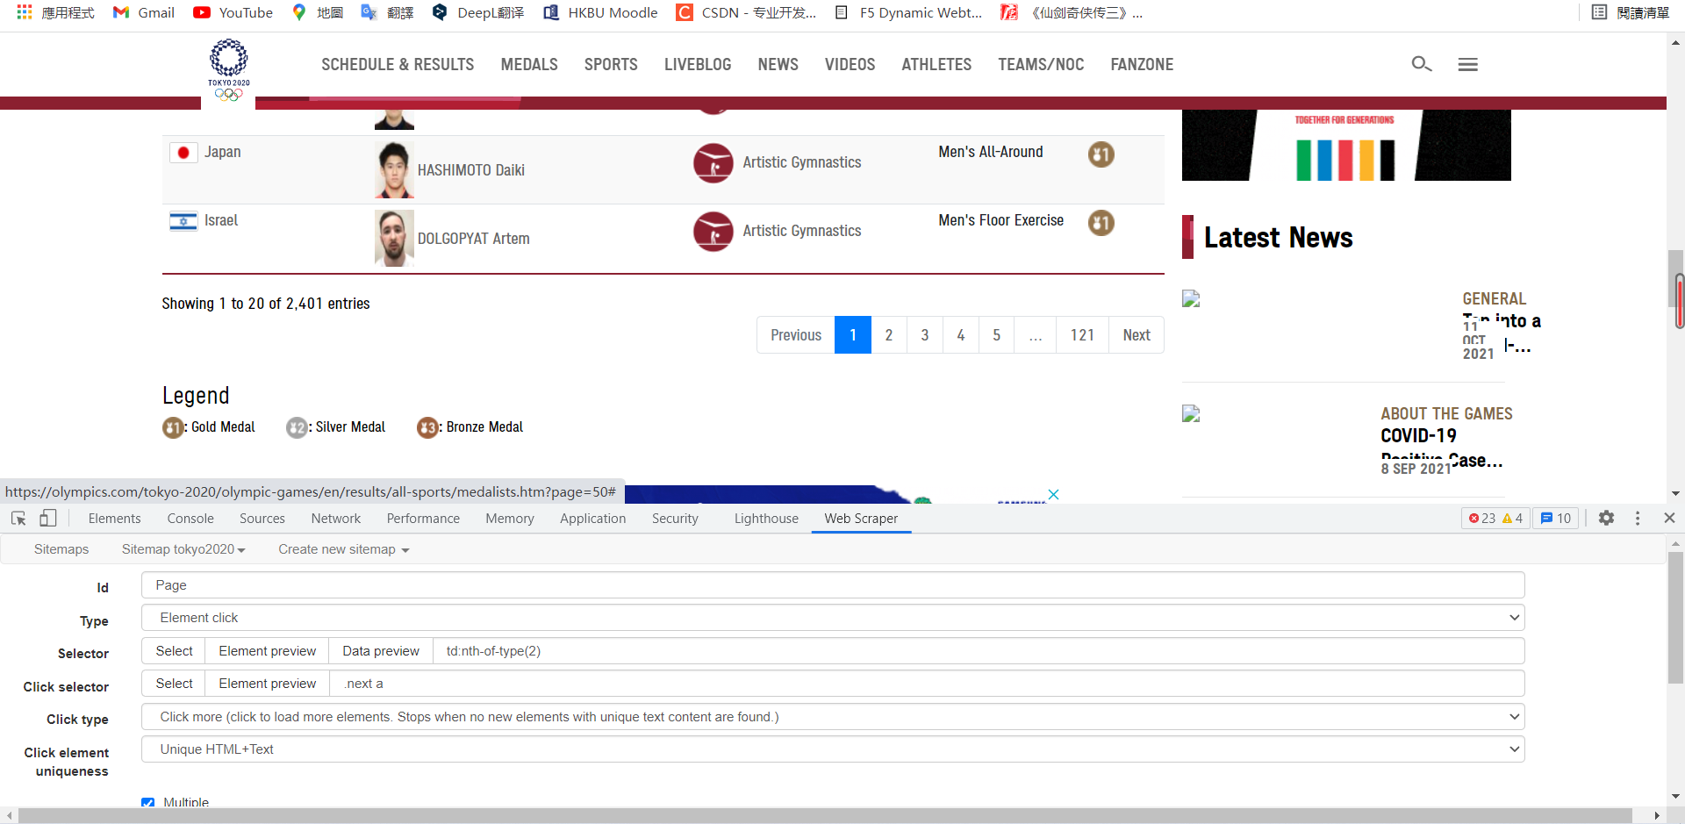
Notes:
It have different pages, so I must learn how to scroll down to get more data. I searched for methods and try them one by one, and scrape for many times. Finally, I know that I need to use the element click to scroll down, otherwise I cannot get the data of every player.

Slide 7
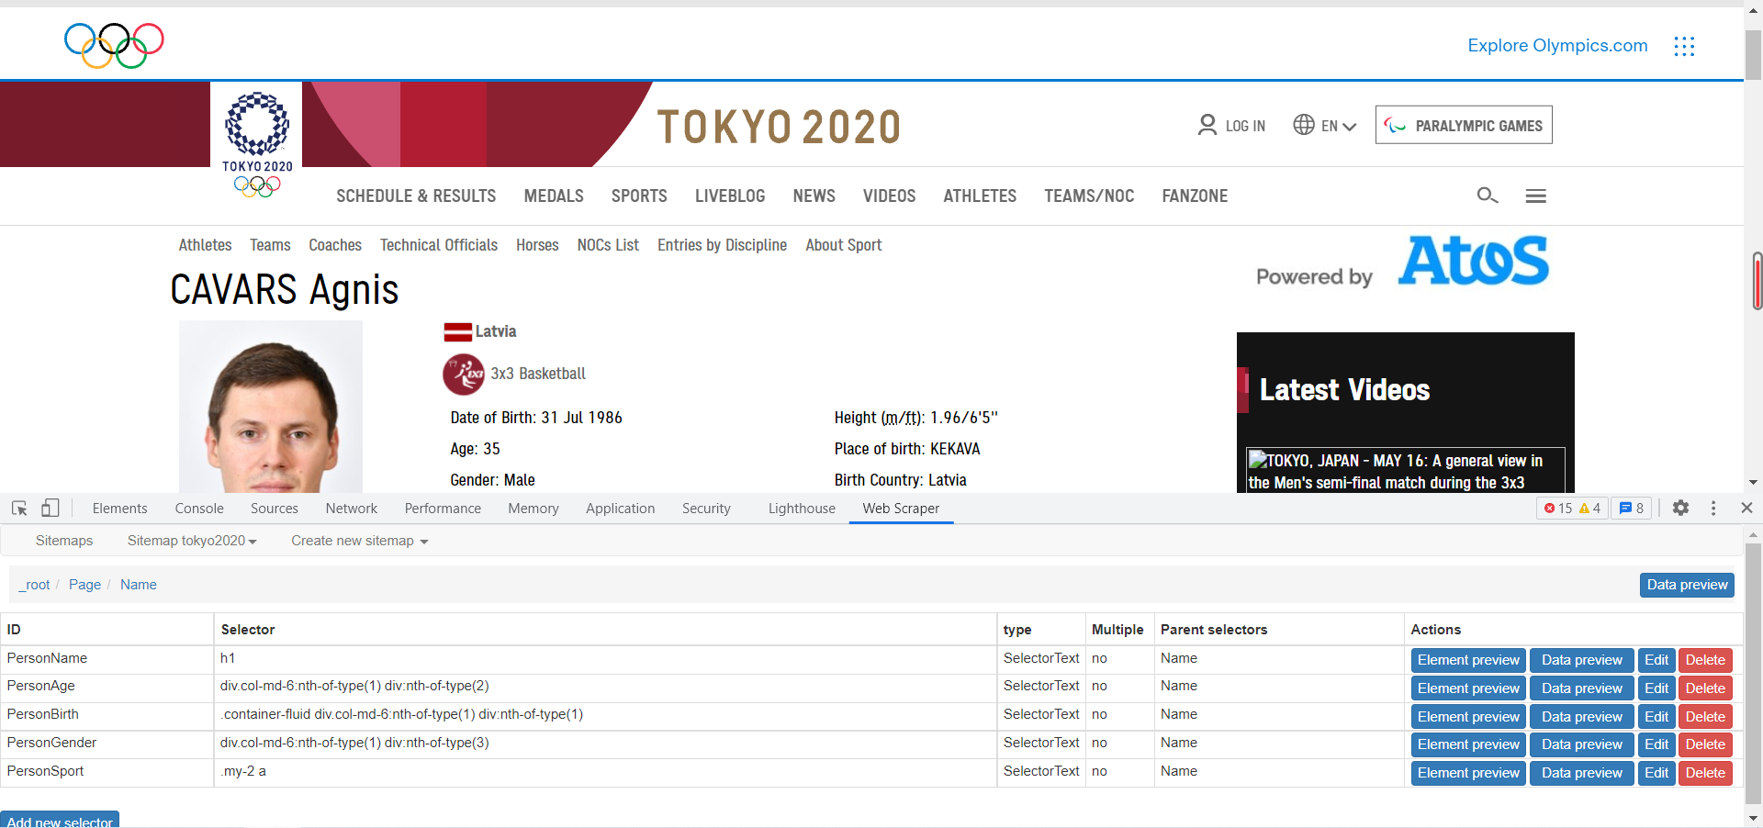
Notes:
Get the individual data

Slide 8
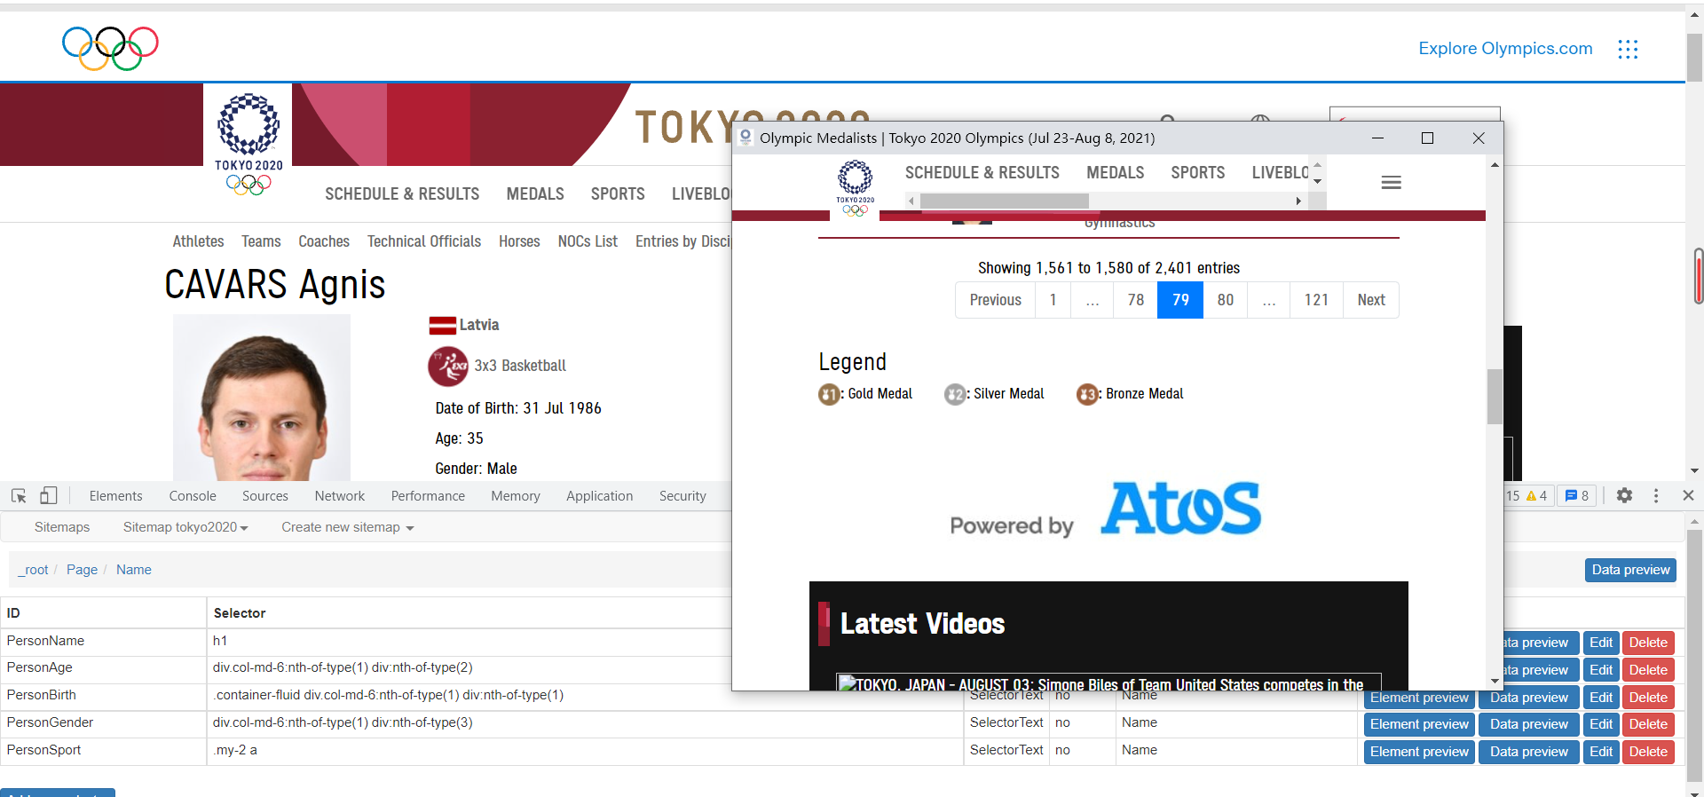
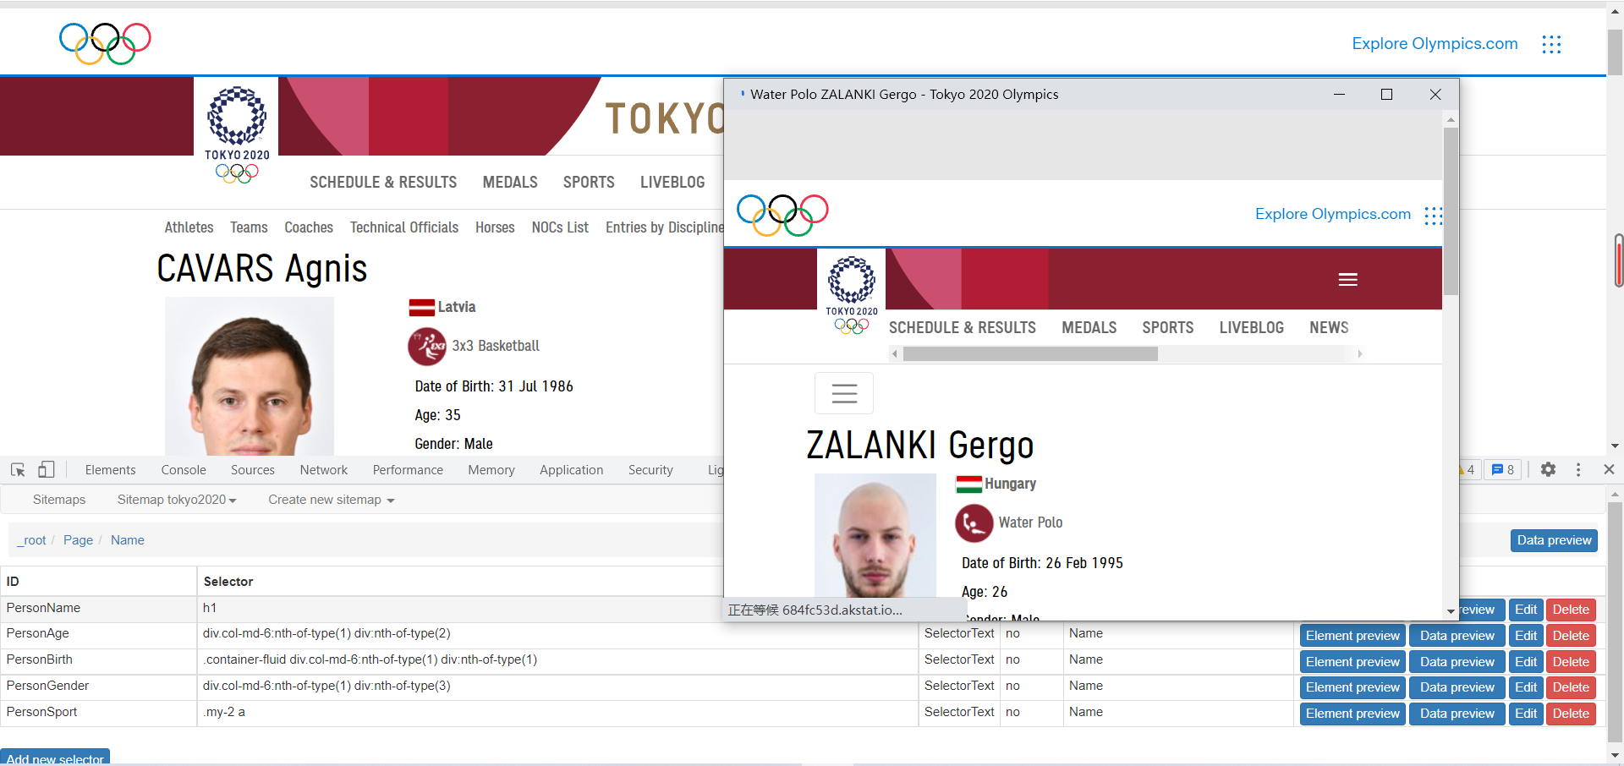

Slide 9
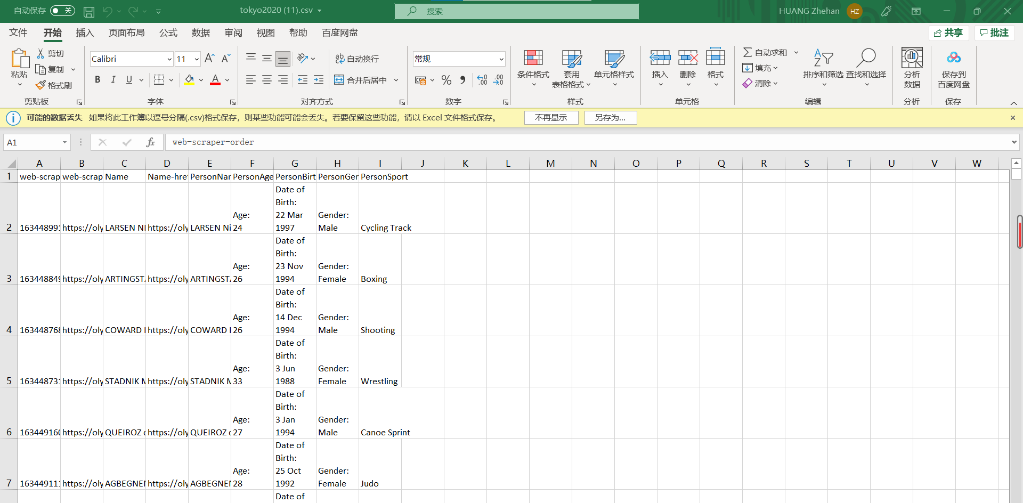
The process of cleaning data
Notes:
It must be the most easy part. Cuz I scrape the data by myself, the data is normal, and doesn’t have some strange numbers.

Slide 10
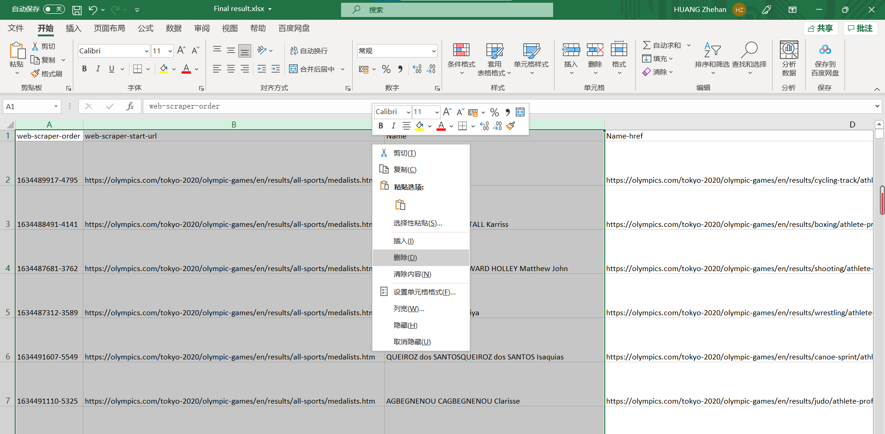
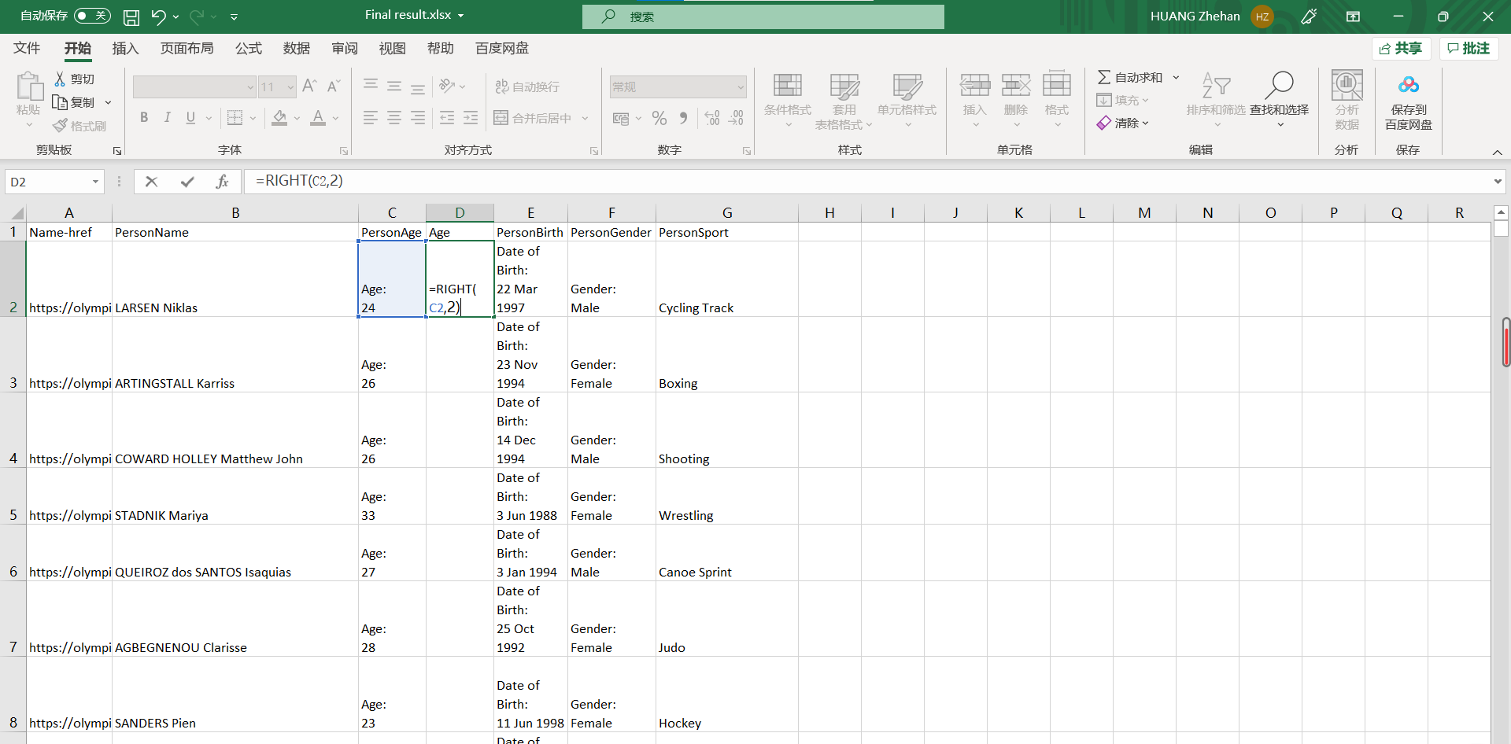
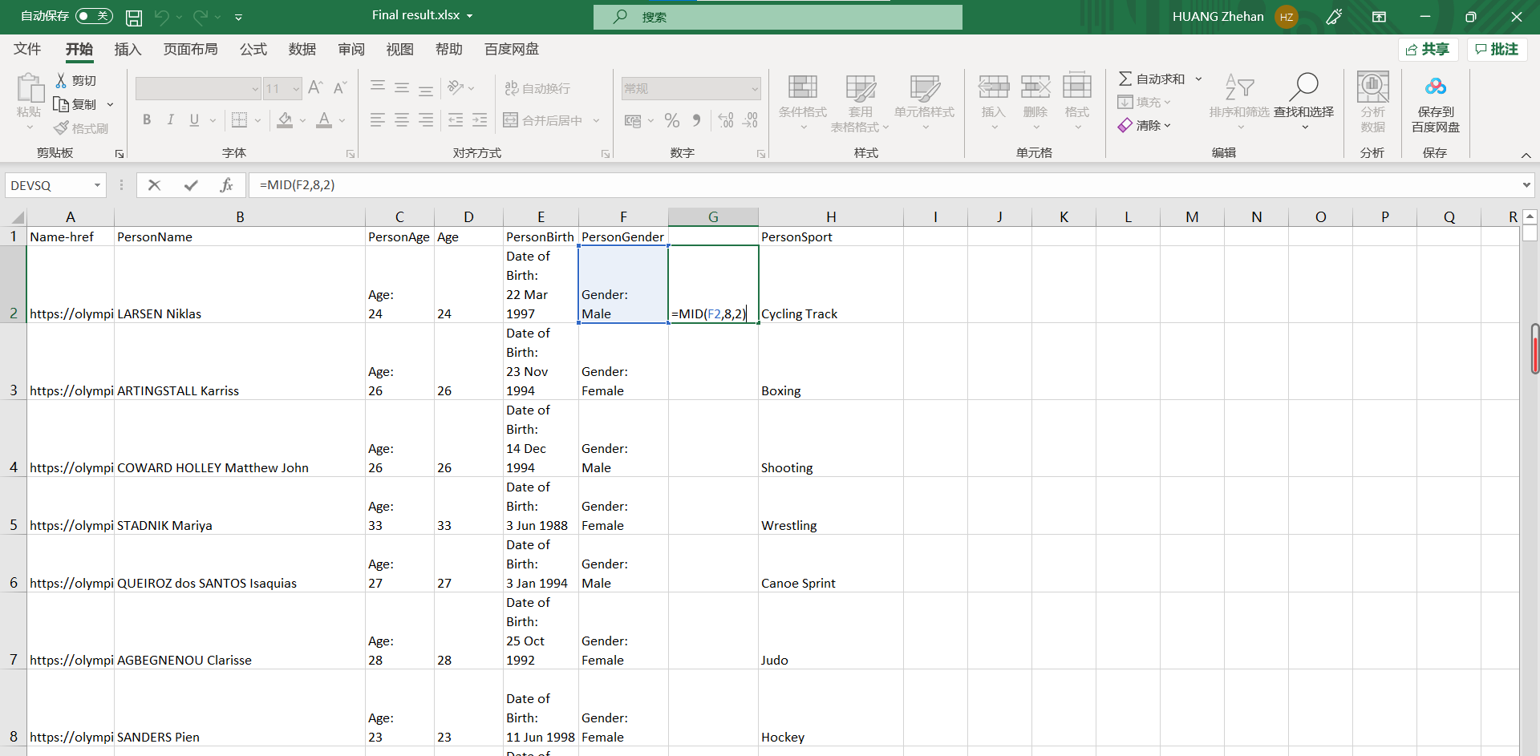
Notes:
I just delete unnecessary data, delete unnecessary words, and use the easier expression.

Slide 11
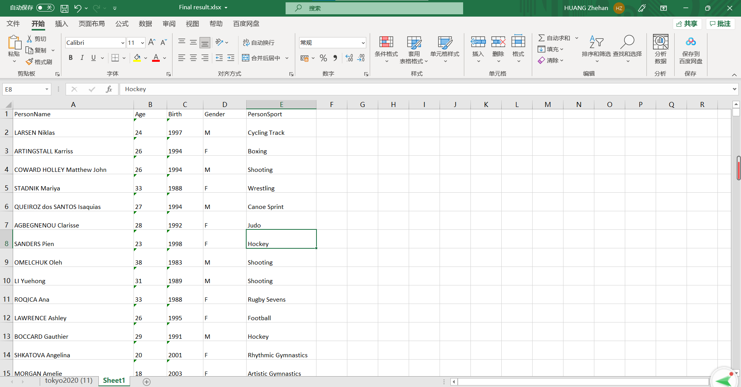
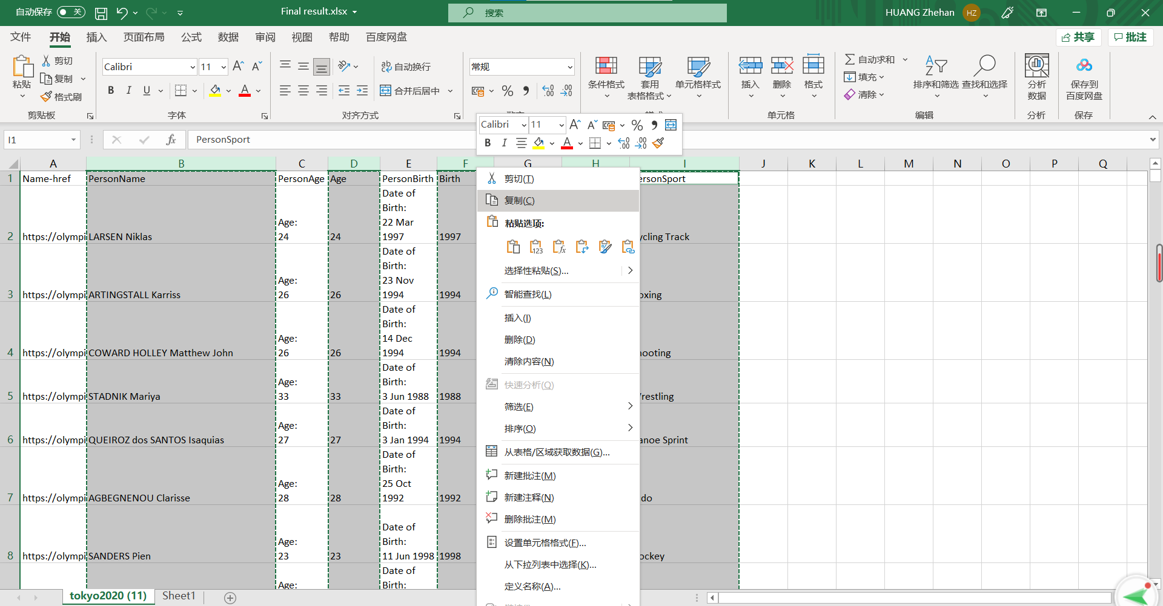
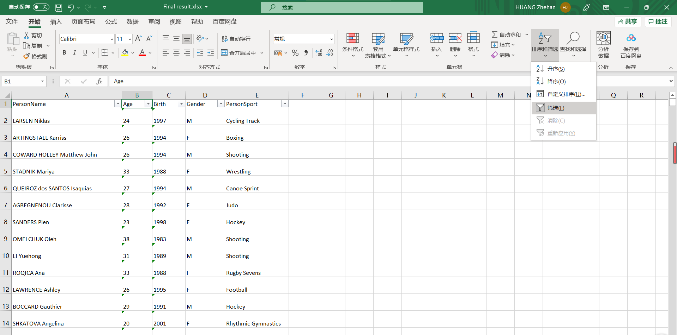
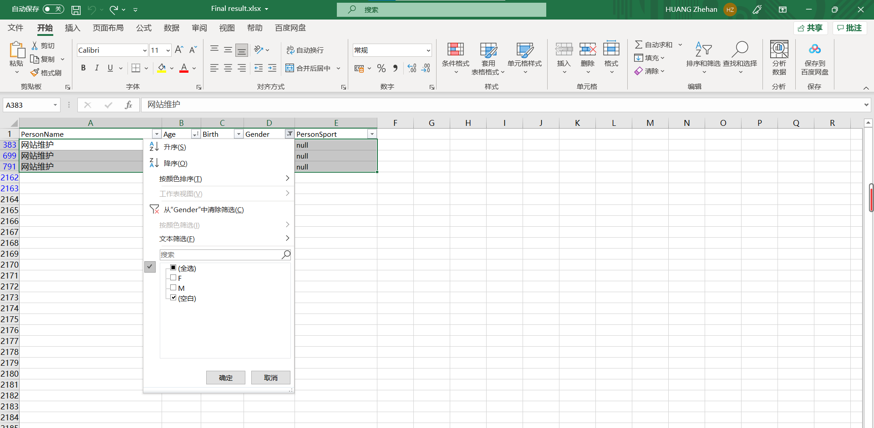
Notes:
And Filtered some blank data

Slide 12
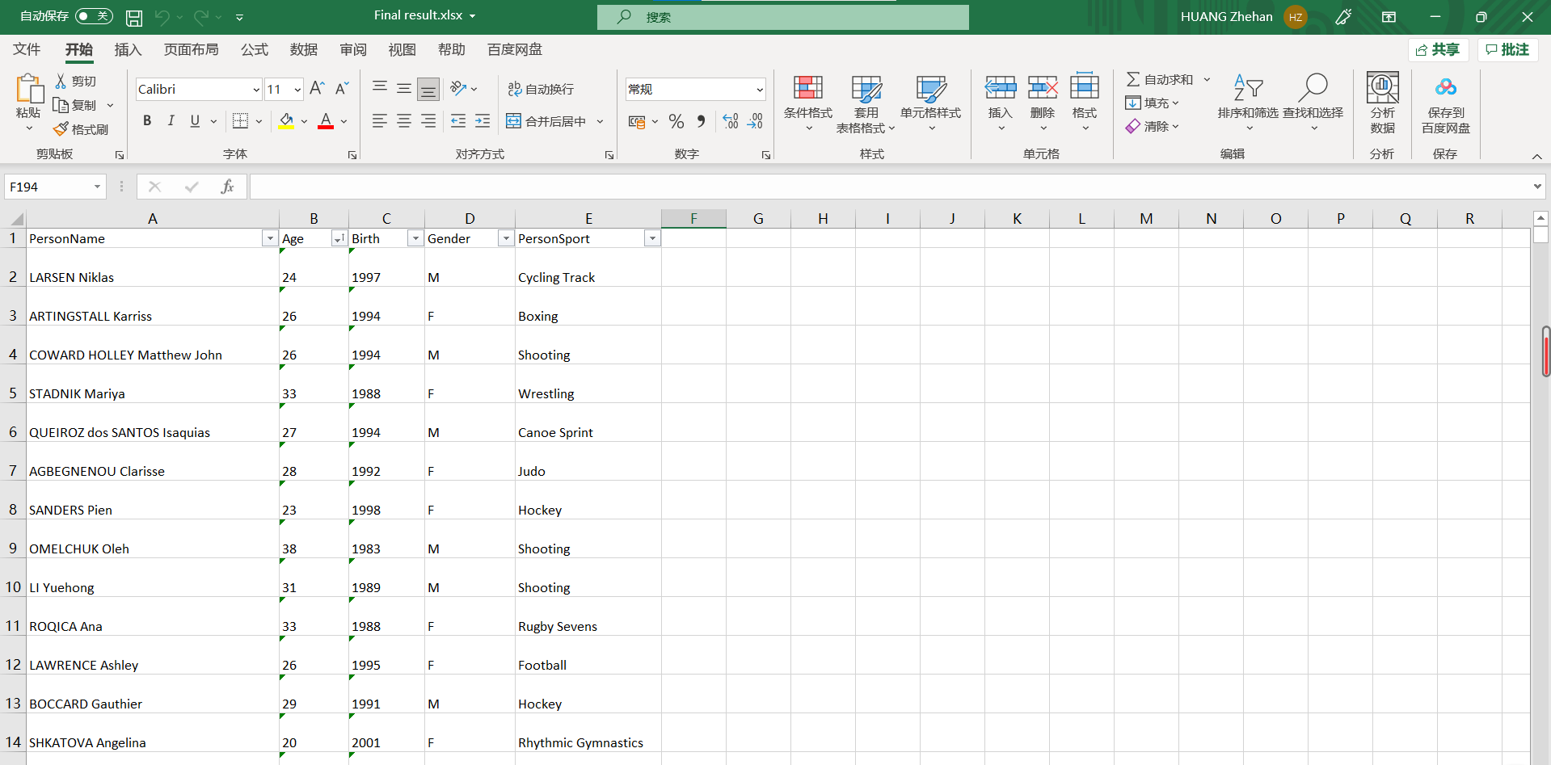
Notes:
Finally, I get the pure data of all winners in Olympics 2020.

Slide 13
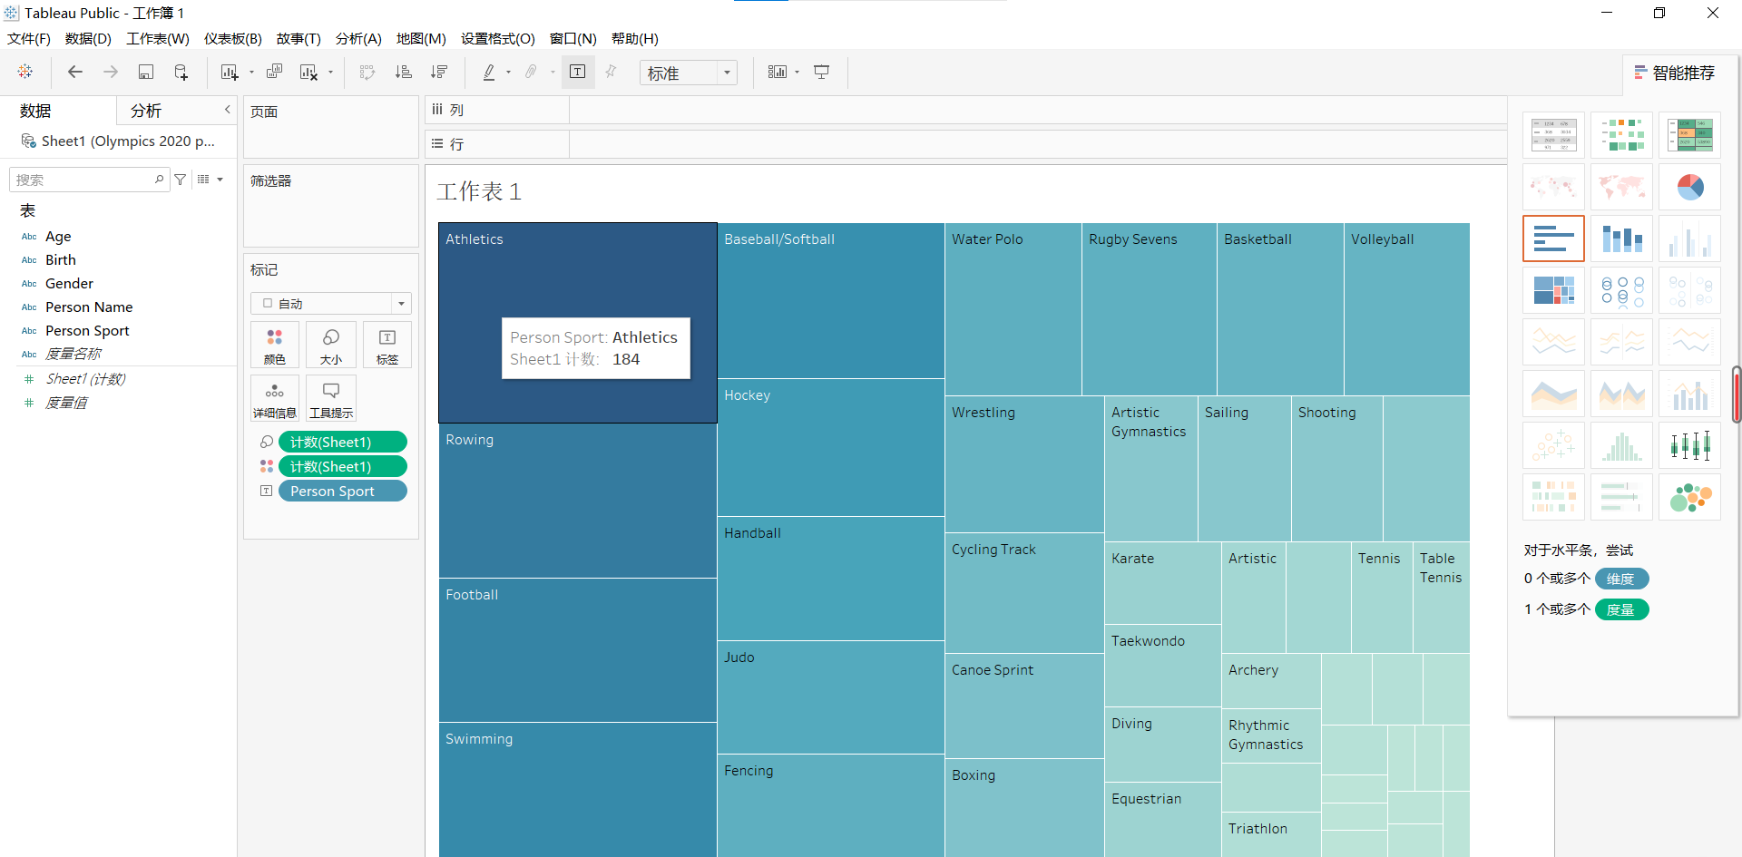
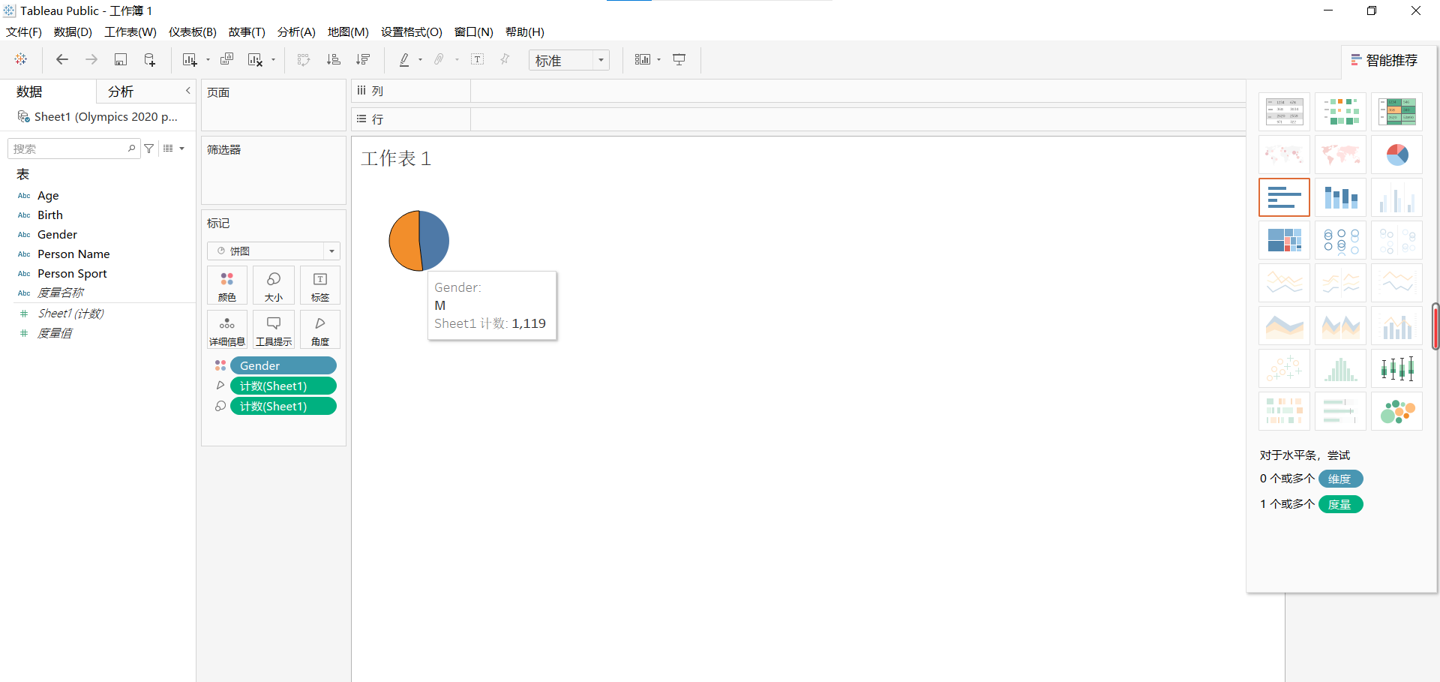
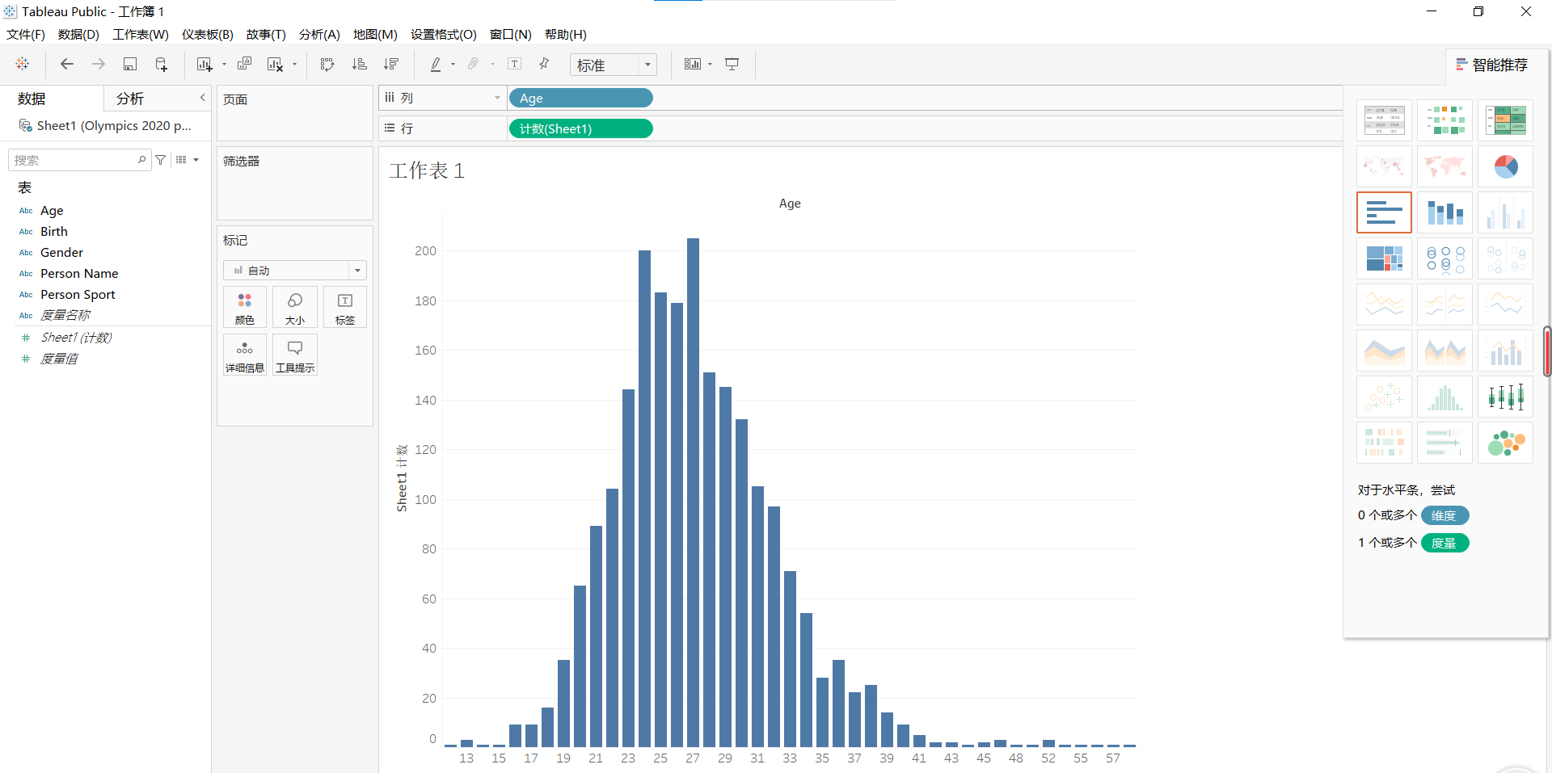
Data analysis
Try Tableau first:
Notes:
But I find the Tableau is little complex and inconvenient. I need to drag several frames all the time. So I use Excel finally.

Slide 14
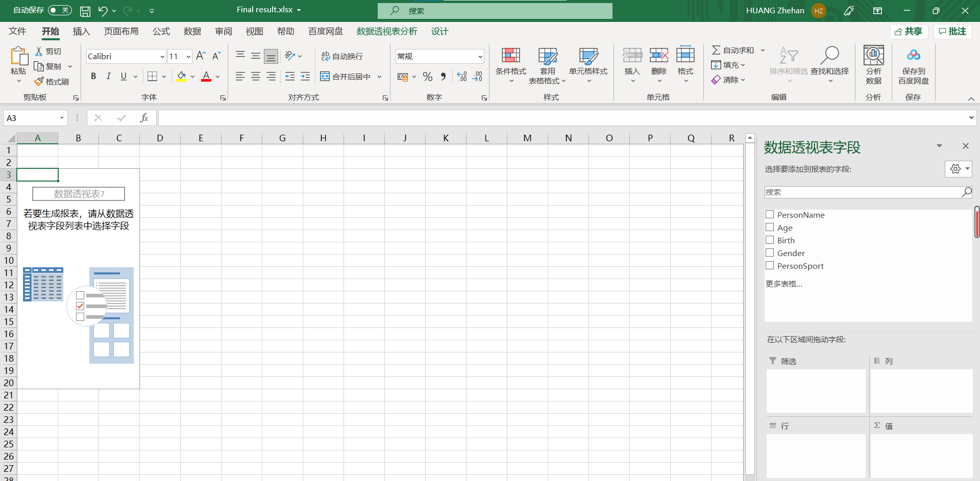
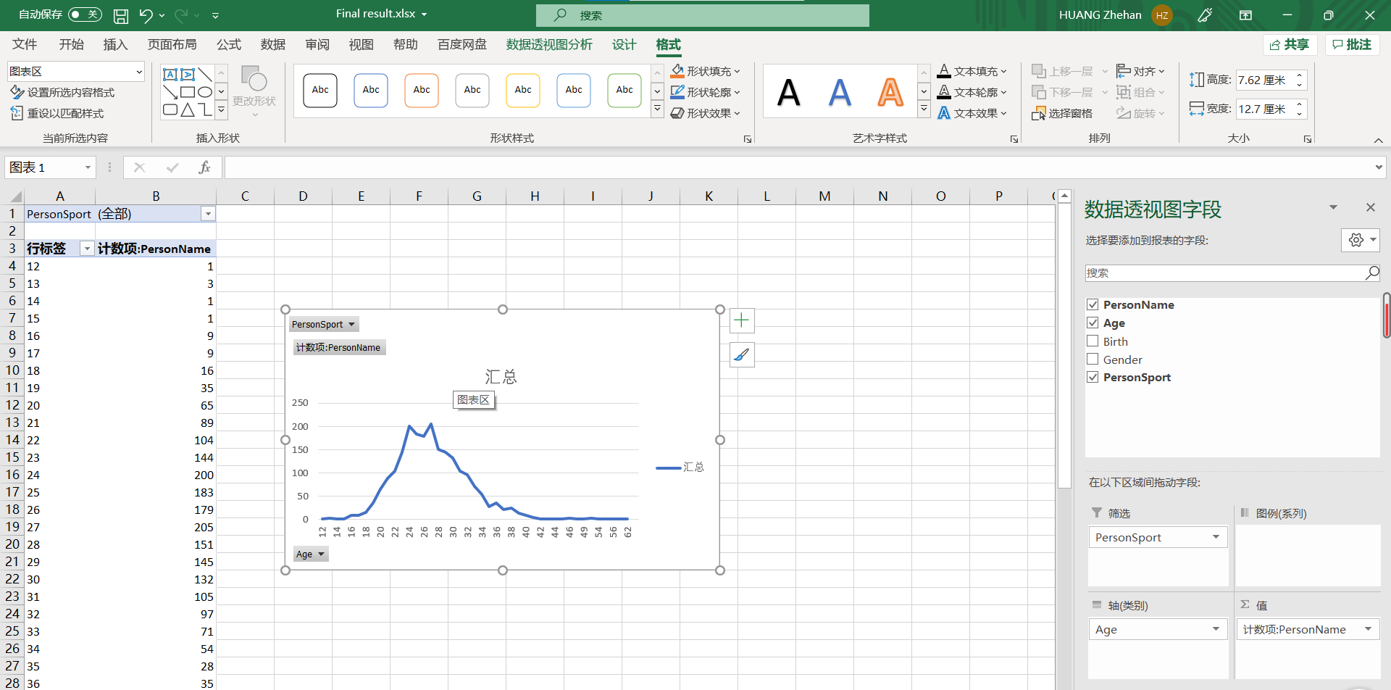
After some tries, I get the table 👆
https://www.theguardian.com/sport/2021/aug/02/australia-oldest-olympic-medalist-andrew-hoy-tokyo-2020-eqestrian
Notes:
After some tries, I draw the overall figure:
The oldest man is 62 years old, some news had reported him: https://www.theguardian.com/sport/2021/aug/02/australia-oldest-olympic-medalist-andrew-hoy-tokyo-2020-eqestrian and It is worth to mention that he is not the participating athletes, he is the oldest winner of Olympics 2020. and Hoy’s overall Olympic medal tally to six: three gold, two silver and one bronze.

Slide 15
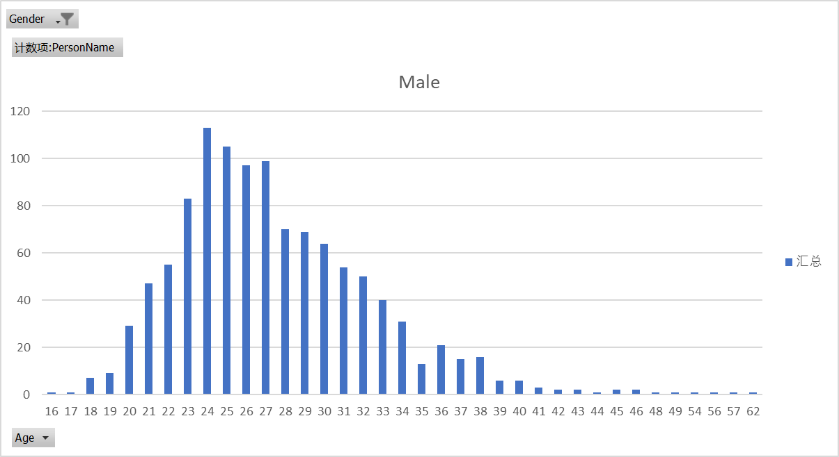
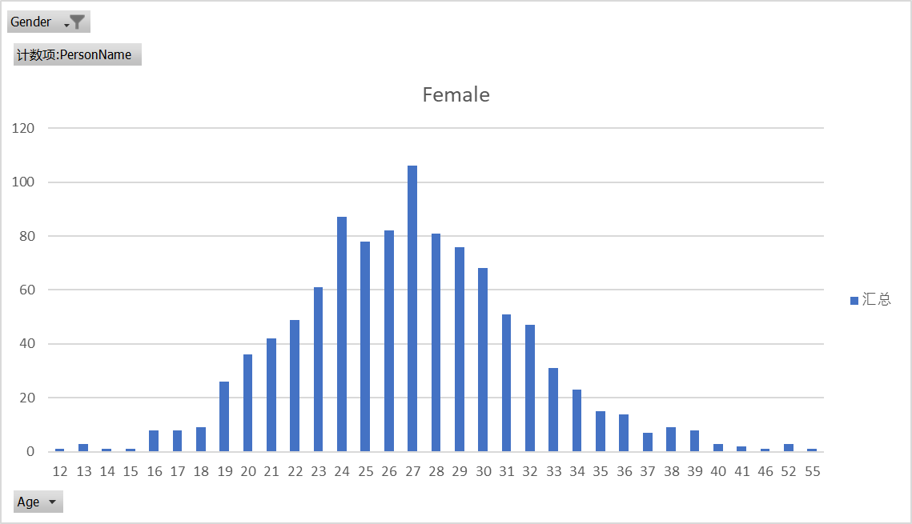
Female & Male
Notes:
Then I analyze the performance of two genders in the age: it seems that the data show that female will be more likely to win when they was young. But is not accurate to say that because for some sports, there are age limits. and it is just one time, for Olympic 2020. if I want to prove the hypothesis, I may need to collect data from pervious Olympics.

Slide 16
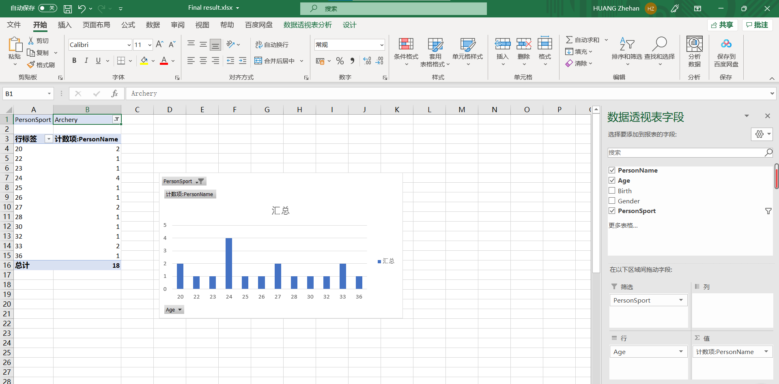
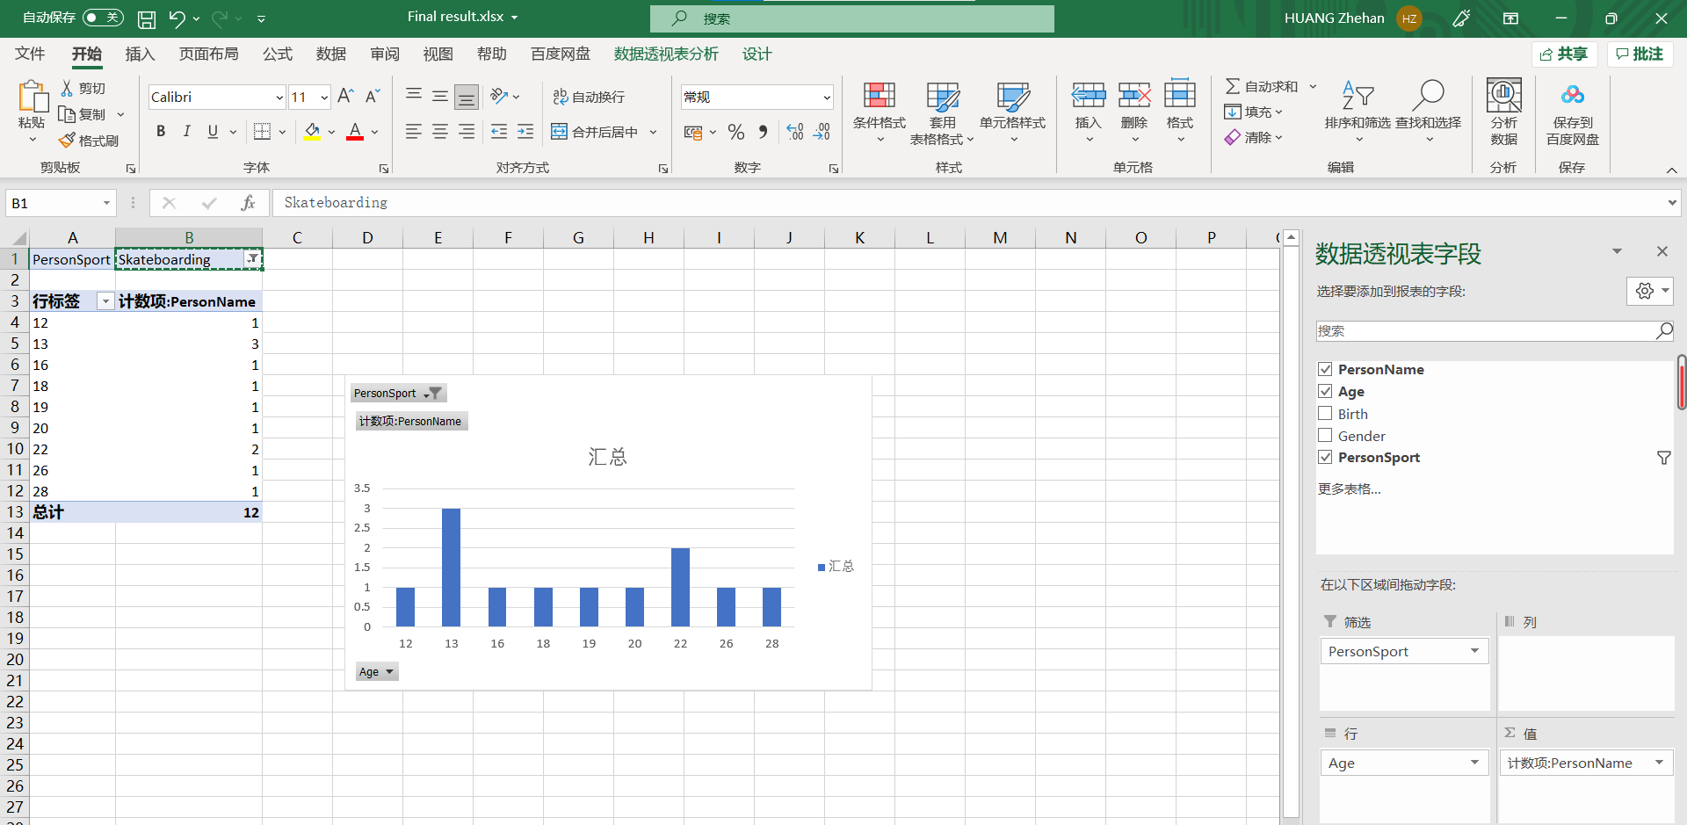
Project Goal
In each kind of sports, what age of the players are more likely to get achievements?
Notes:
Don’t forget my project goal: I want to figure out the relationship between age and winner, like this:
Some sports have a wide range of ages, but some sports have really young winners and narrow range of ages, like Artistic Gymnastics. That’s because it needs a certain degree of flexibility.
What makes me amazing is there is a 12-year-old player win the prize in skateboarding and two 13-year-old player. https://www.cbsnews.com/news/sky-brown-13-year-old-skateboarder-wins-medal-tokyo-olympics/

Slide 17
Improvements:
1. Little data
2. Tendency
3. Not interesting
Anything else?
Notes:
But the database may be not the end because the data for a specific sport is small, so I want to analyze the recent Olympics player’s age and gain more accurate data.
Also, I want to see the tendency of the age, if there is a tendency that winners get more and more younger.
Make the data more interesting, like the news of our guest.
That’s end of my presentation. I want to get more suggestions from you.

